Slide 1
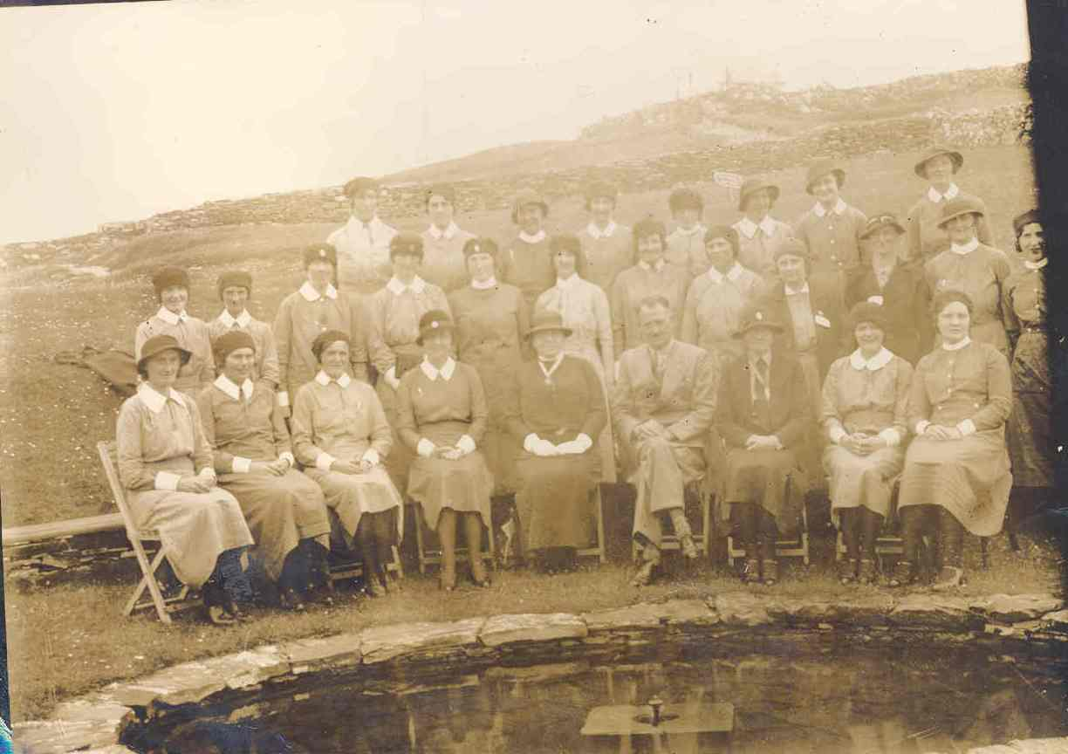
From the Cradle to the Grave: District Nursing in County Donegal

Slide 2
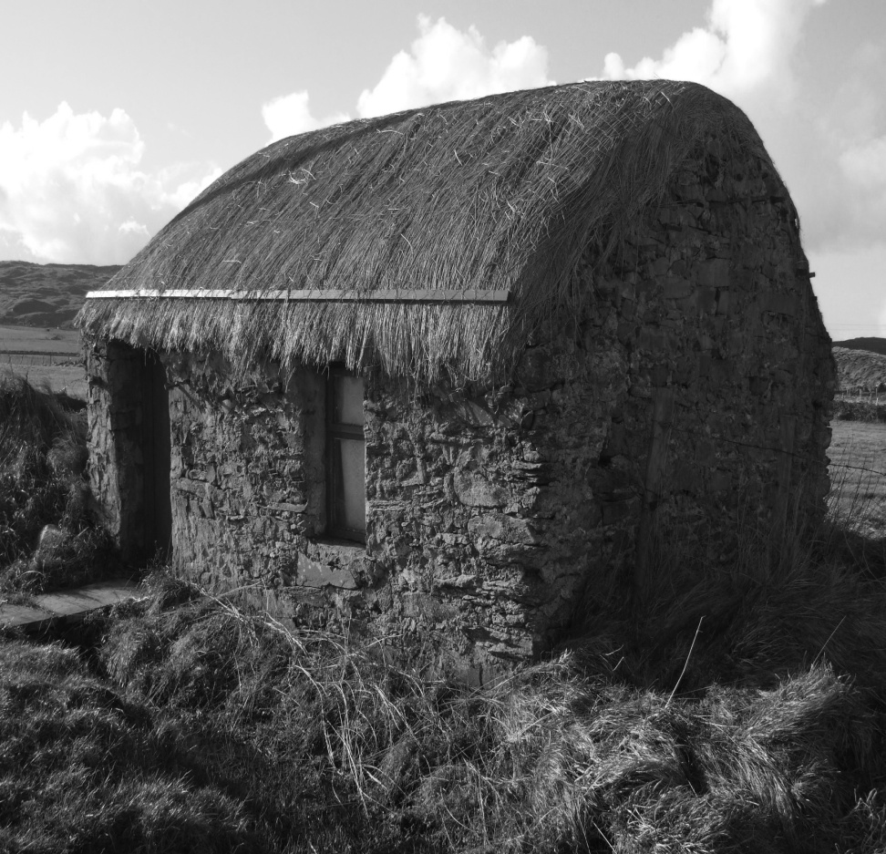
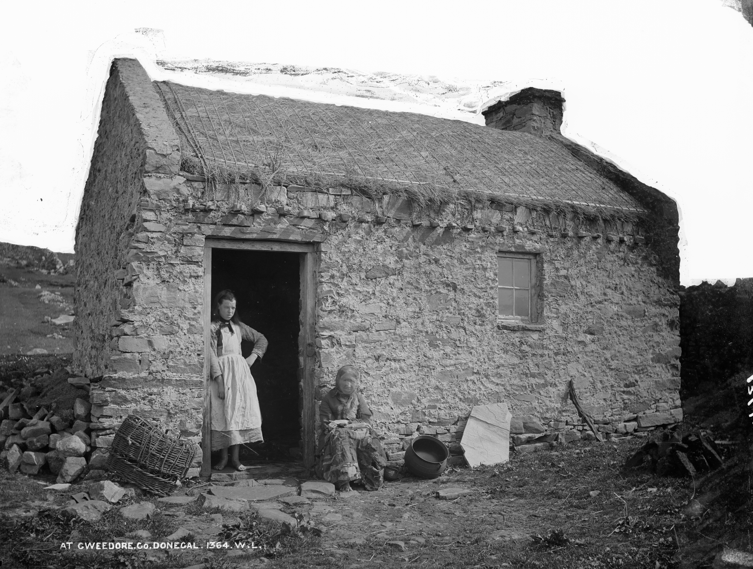
Cottages in west Donegal, 1900s

Slide 3
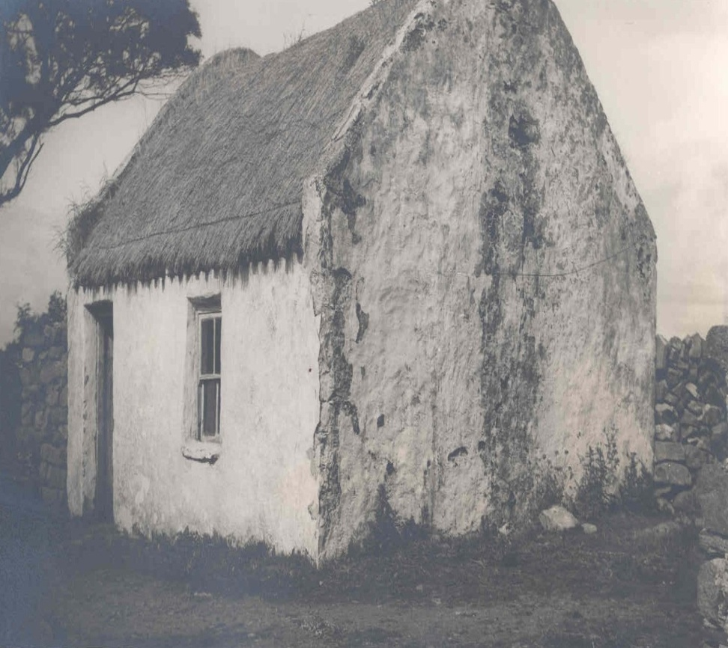
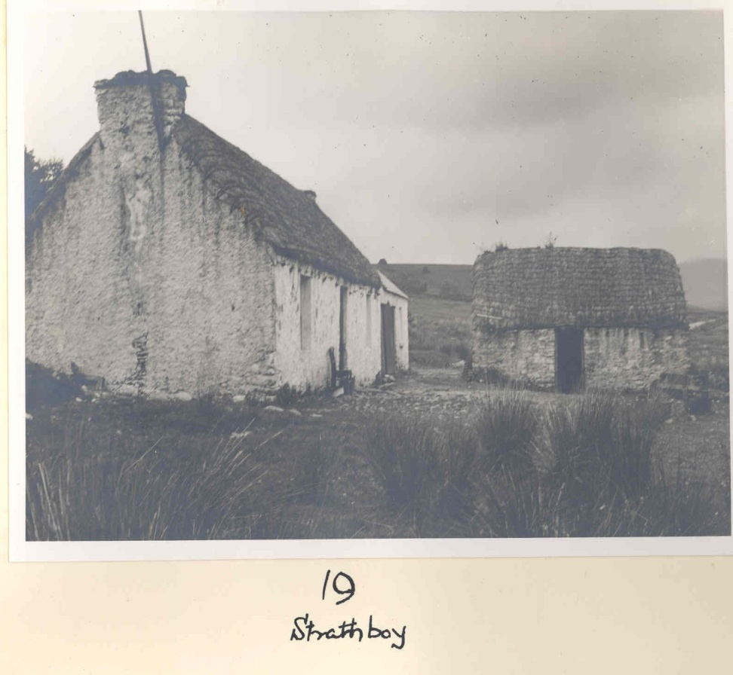
Cottages in west Donegal, 1940s

Slide 4
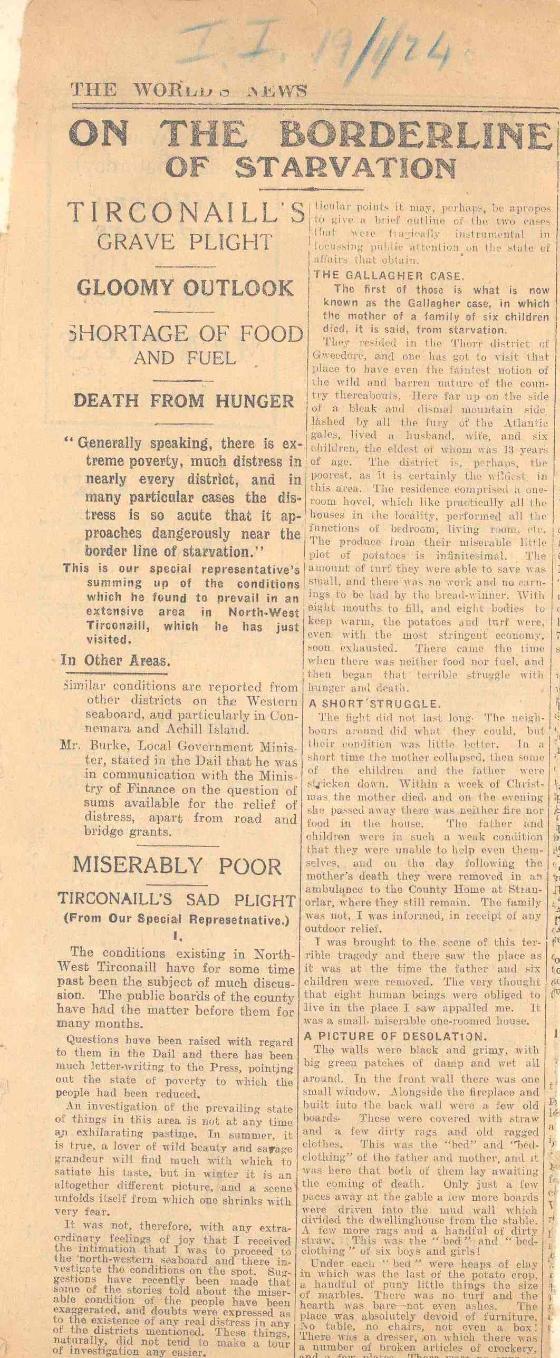
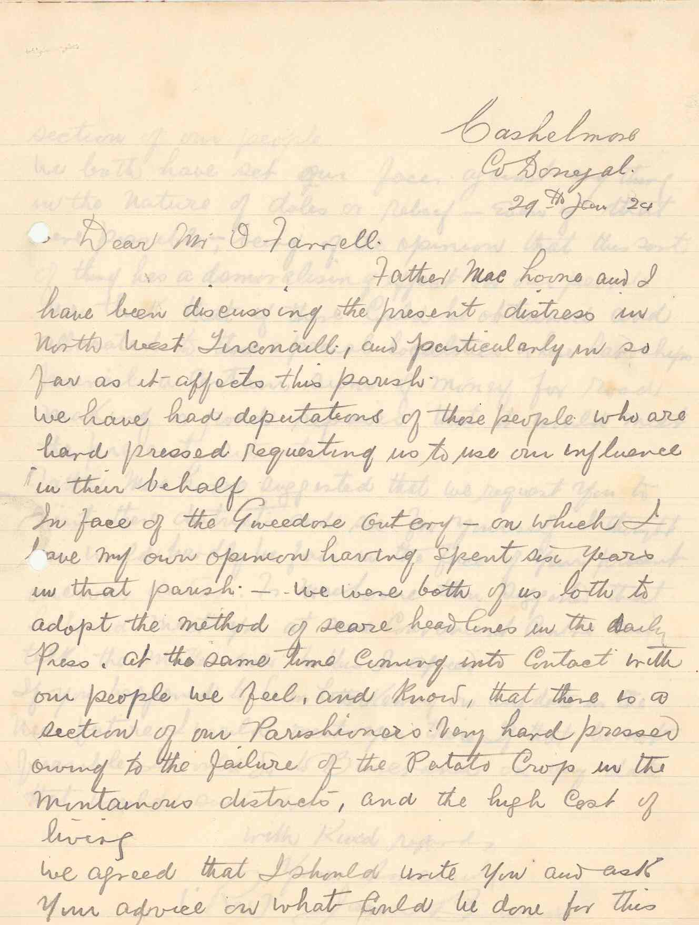
Letters & newspaper accounts re 1920s ‘distress’ in West Donegal

Slide 5
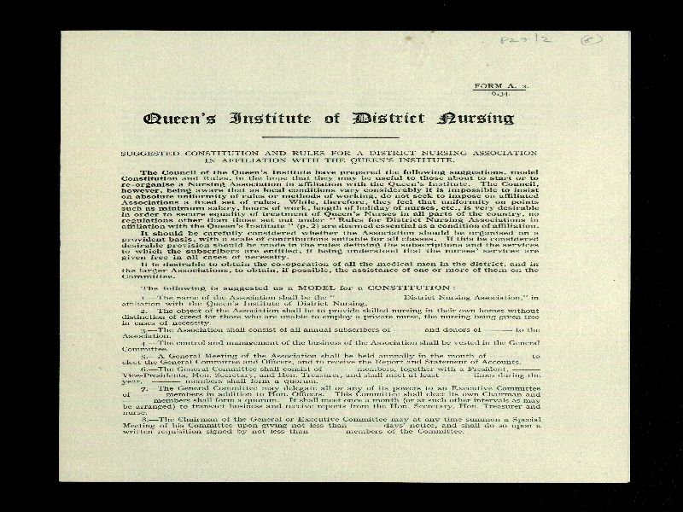
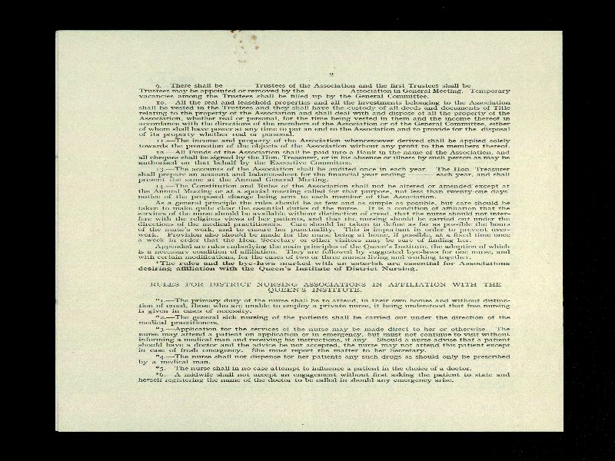
Queen’s Institute of District Nursing Rules, By-Laws

Slide 6
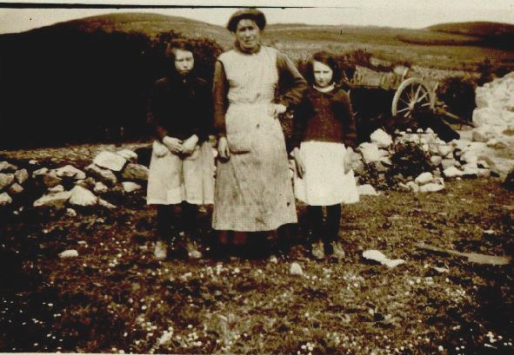
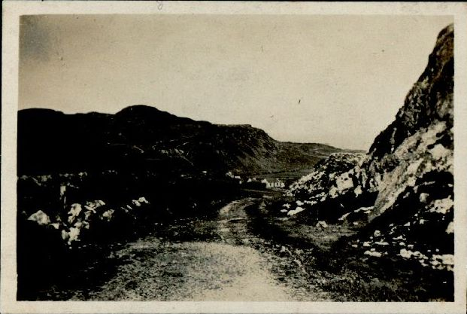
Images from Fanad Health Club Minute book, c.1930s

Slide 7
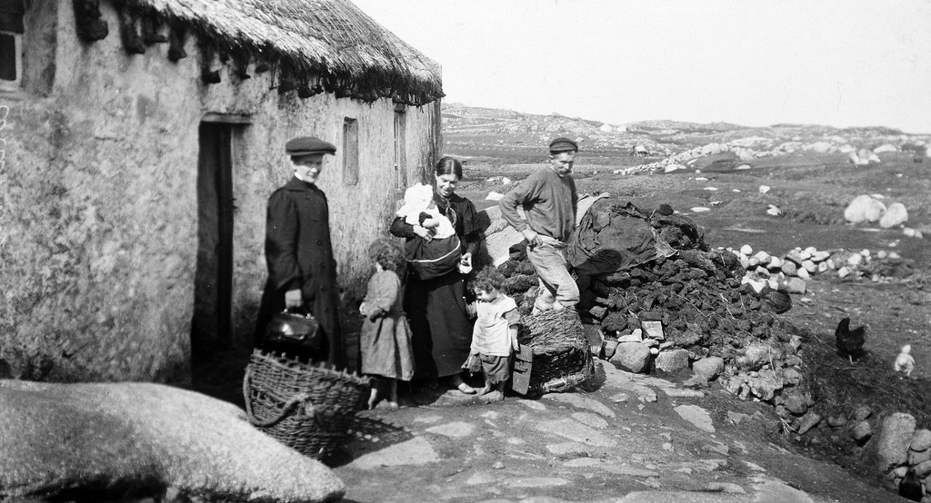
Public Health Nurse visits Arranmore Island (@NLI), 1900s

Slide 8
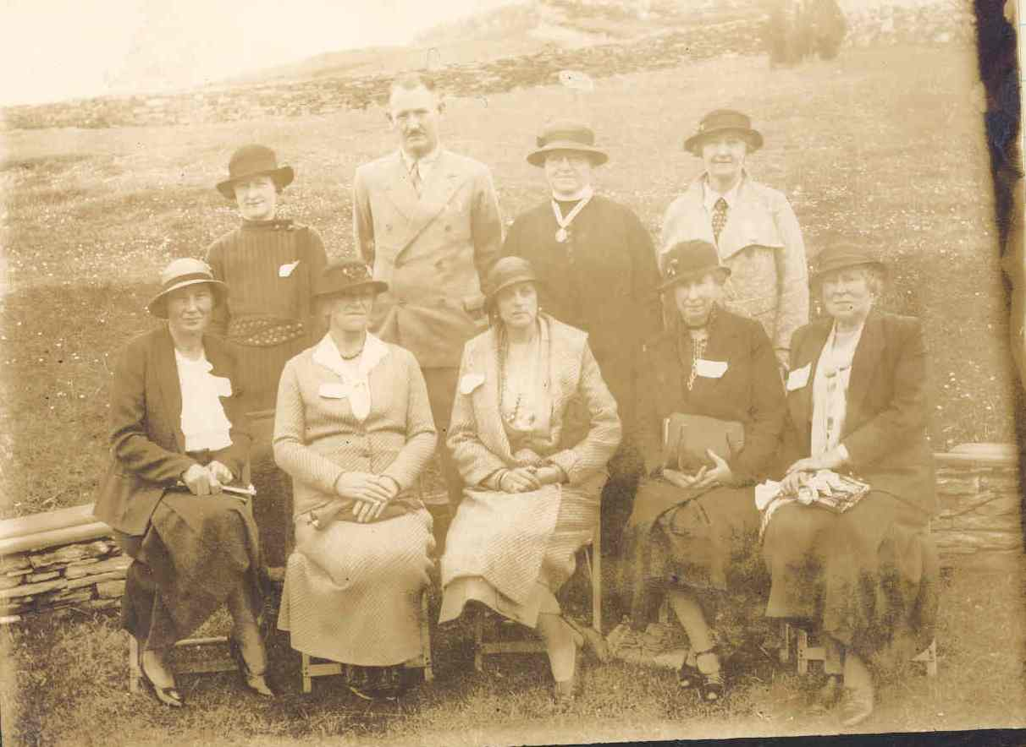
Edith Hart, Dr O’Deagha and other leaders of Fanad Health Club initiative, 1930s

Slide 9
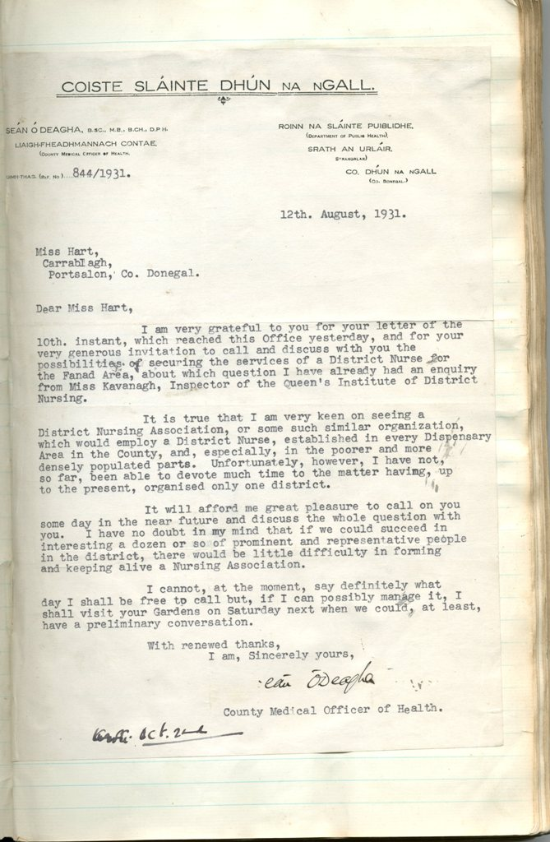
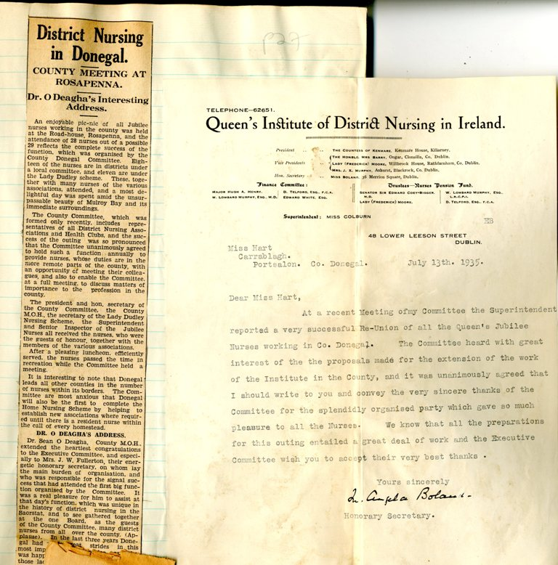
Letter from Sean O’Deagha, Co. Medical Officer, to E. R. C. Hart re setting up of Fanad Health Club, 1931 & letter from Queen’s Institute Hq. to Hart, 1935

Slide 10
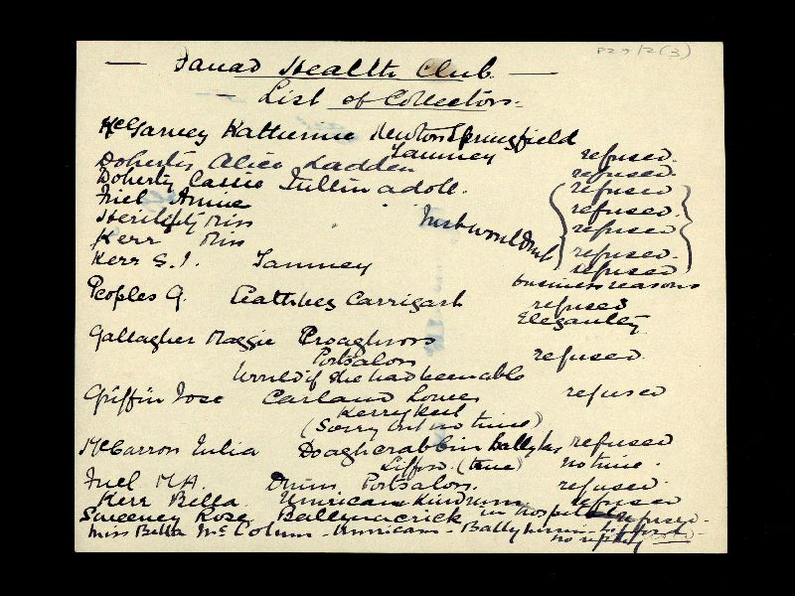
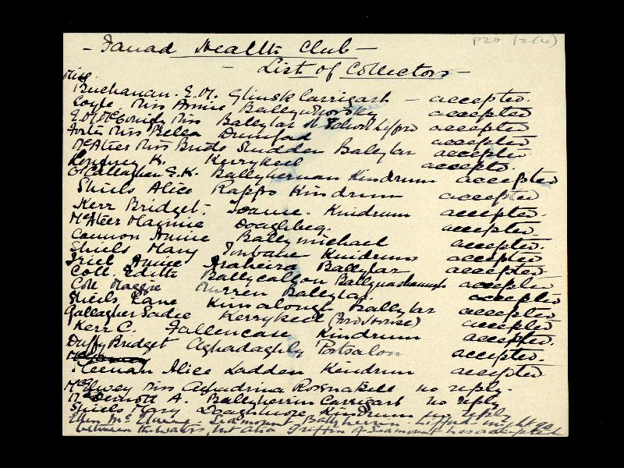
Fanad Health Club, list of subscription collectors, 1931

Slide 11
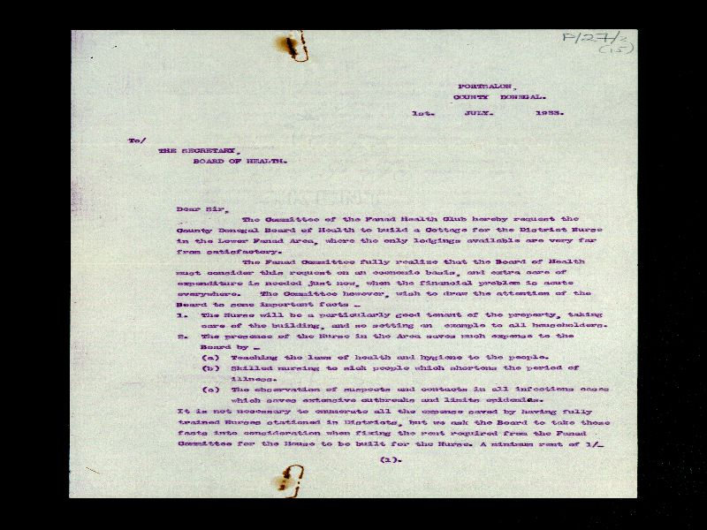
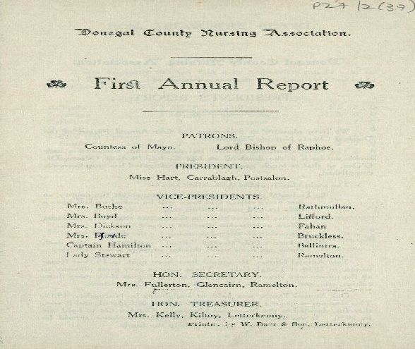
First Annual Report & letter from Hart to Board of Health seeking cottages for nurses

Slide 12
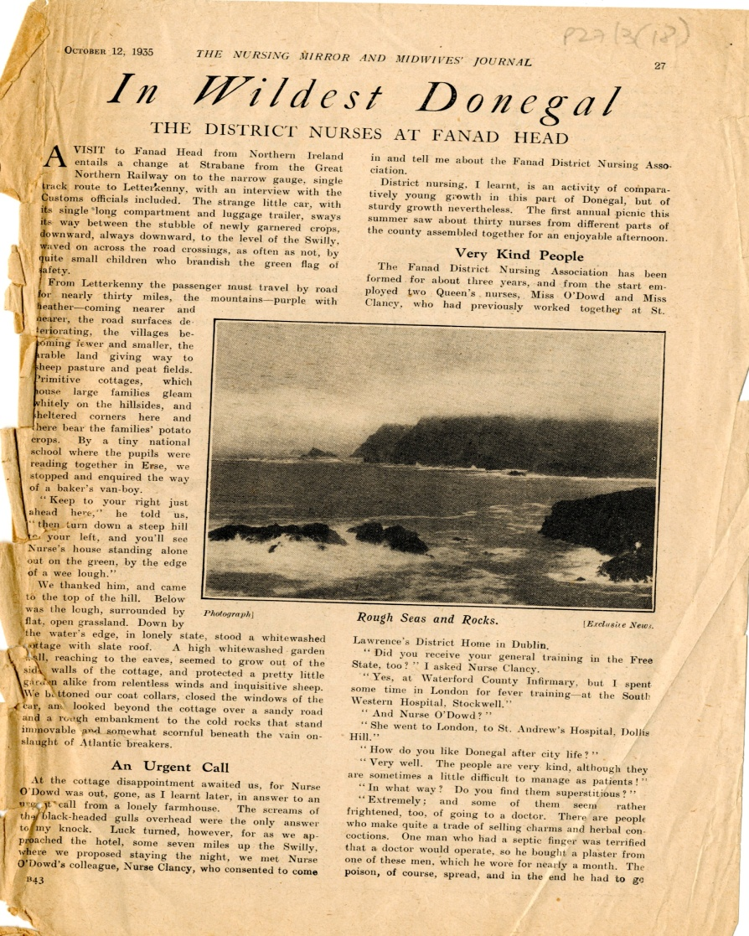
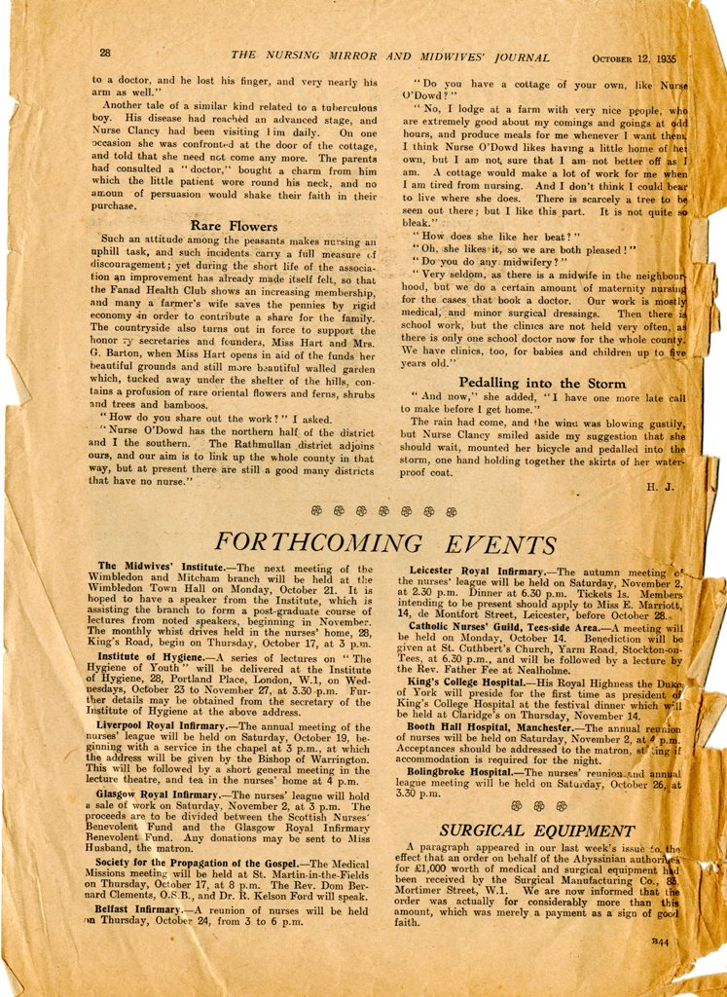
Interview in nursing journal with Fanad Nurse Clancy, 1935

Slide 13
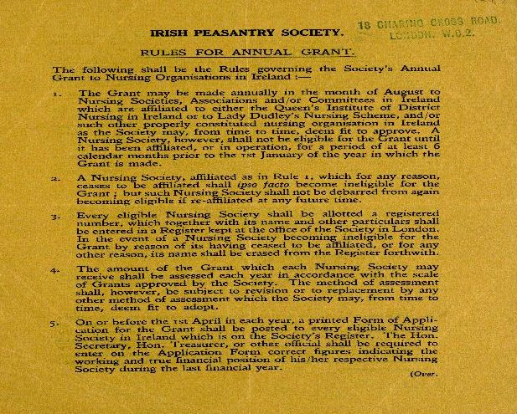
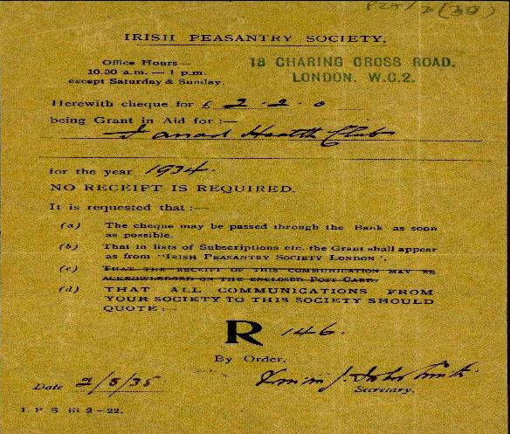
Irish Peasantry Society rules on grants to Nursing organisations

Slide 14
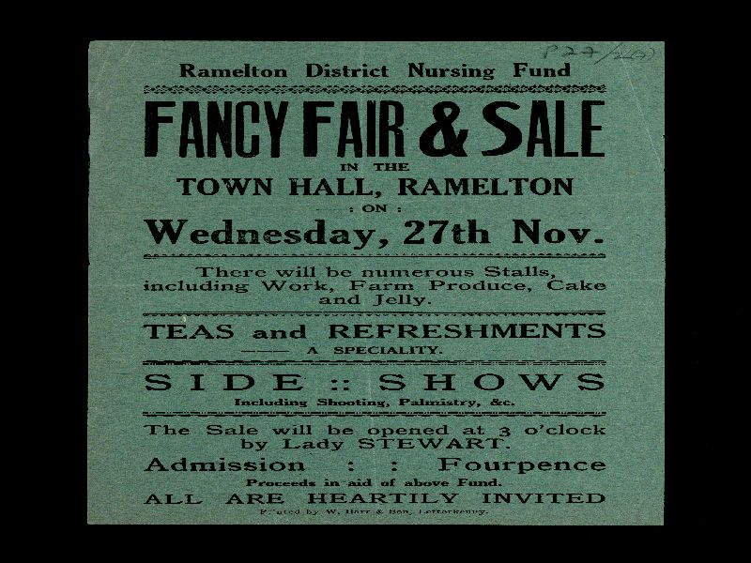
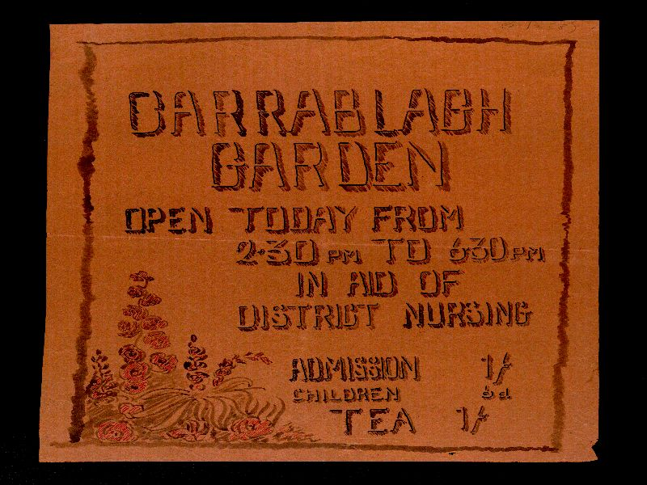
Fundraising flyers

Slide 15
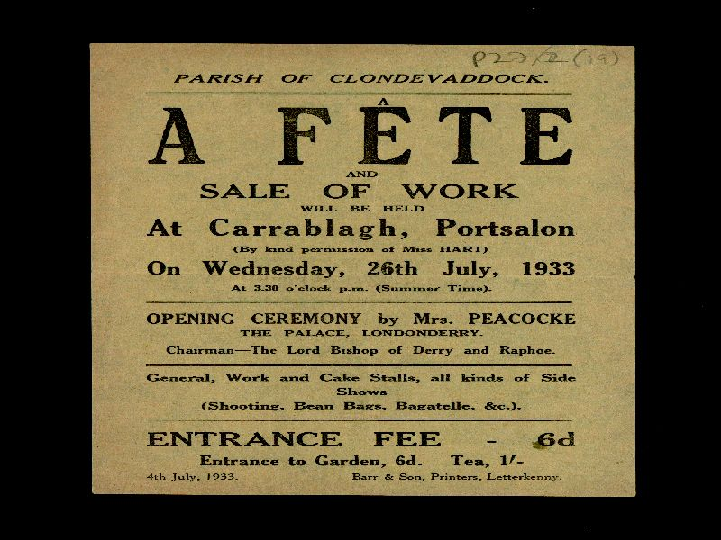
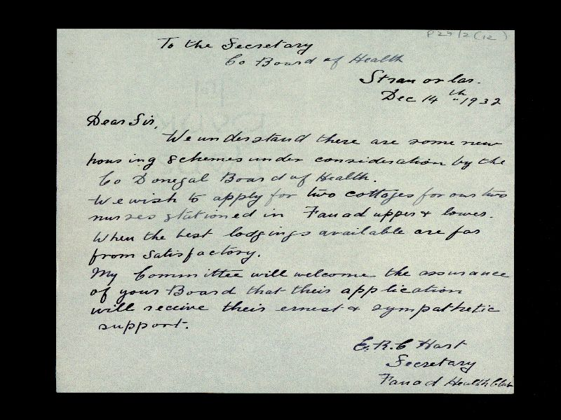
Fundraising flyer & letter re cottage for nurses, 1932

Slide 16
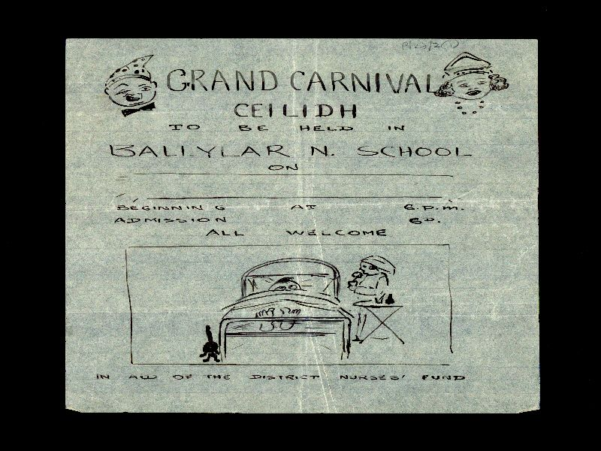
Draft Fundraising flyer

Slide 17
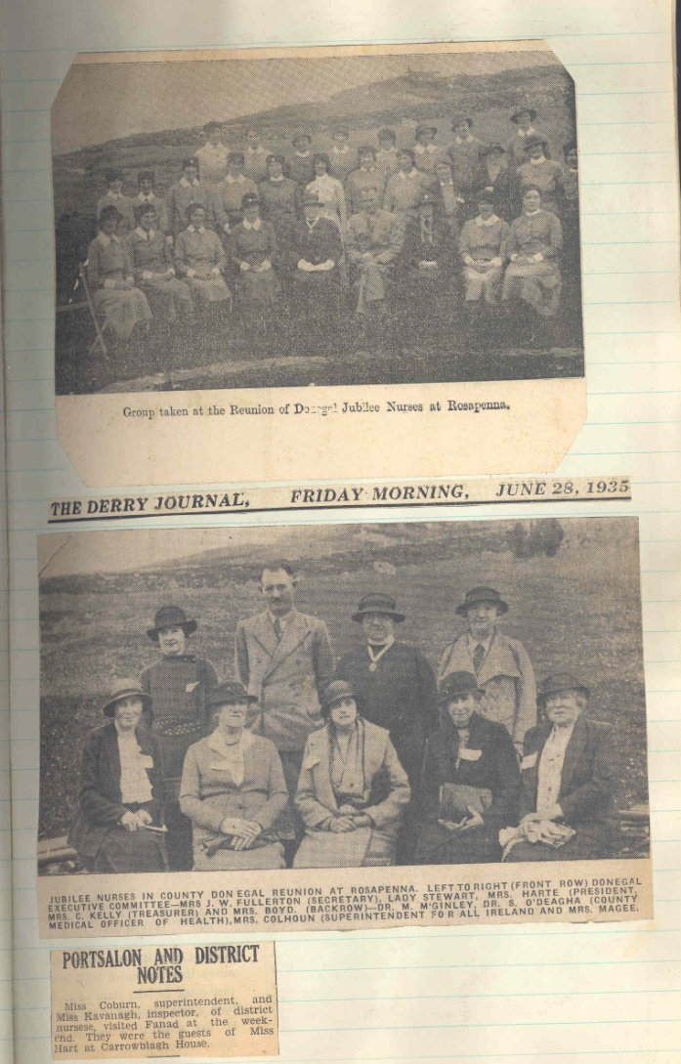
Photos from the press

Slide 18
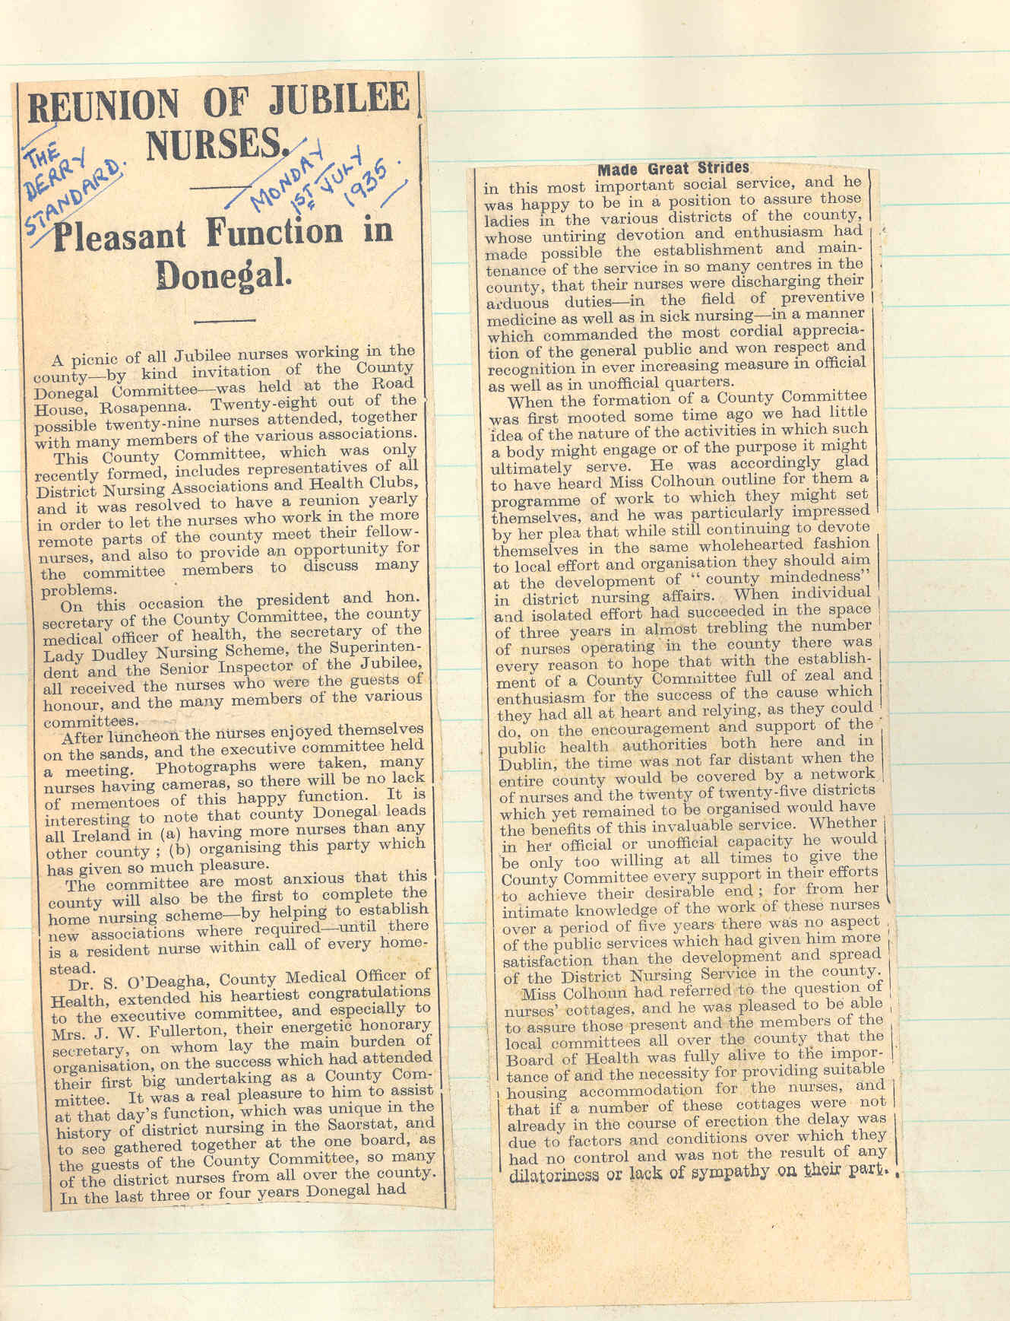
Newspaper report of district nurses social event, 1935

Slide 19
A note on the Archives
Most images shown here are from Fanad Health Club District Nursing Collection, Donegal County Archives.
Images also from other DCA Collections.
Thanks also to National Library for image of Nurse on Arranmore Island.
Website:
http://www.donegalcoco.ie/culture/archives/
Follow us on Facebook and Twitter

